Slide 1


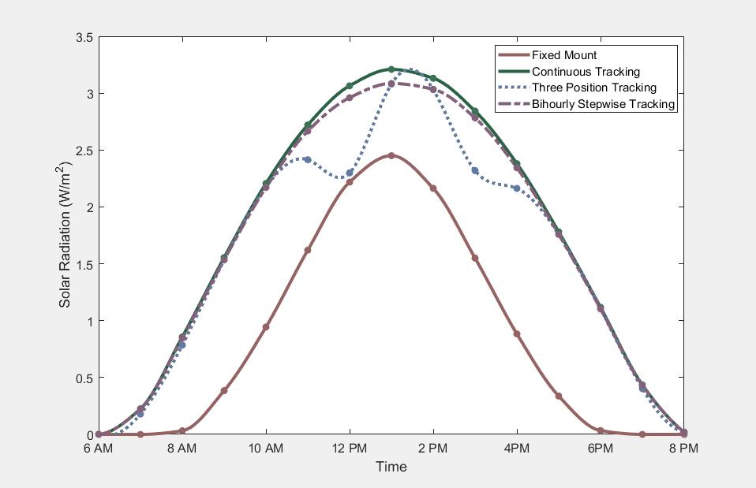


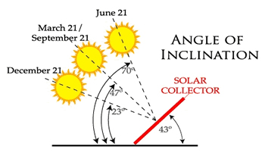

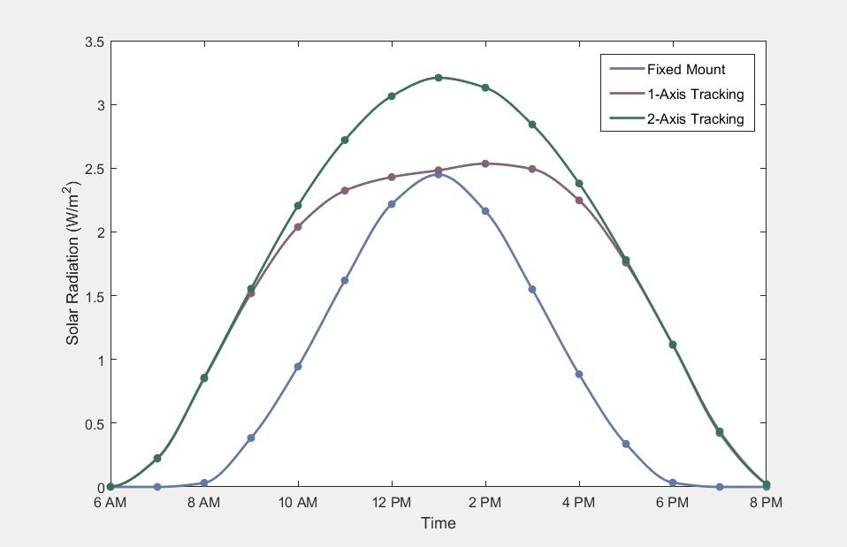
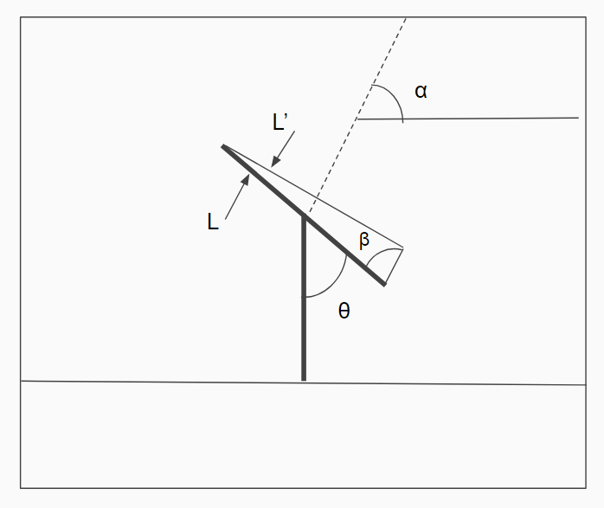
Solar Power Tracking
Justin Hershberger, Garrett Smith, Jon Spies
CS 5890 ------ Machine Intelligence in Clean Energy ----- Spring 2017
Abstract
Calculations
Currently, most photovoltaic solar power systems are simple fixed mount flat panel systems. These systems are typically constructed to optimize the amount of energy obtained from the sun but can utilize 100% of the energy potential. Tracking systems which orient the panels perpendicular to the incoming sun's rays are a potential upgrade to improve the energy output of the system. Our project was to model a fixed mount system and two different tracking method systems to predict the overall improvement to the systems efficiency. Results show that these tracking methods greatly improve the energy output of the system.
The Astral package returns azimuth, and elevation angles for the sun. Using Equation 1 the angle of difference, β, from the panel elevation angle and the sun elevation angle can be calculated.
(1)
Equation 2 can then be used to calculate the perpendicular projection of the length.
(2)
These two equations can be repeated using the azimuth angle of the sun and the direction angle of the panel to calculate the perpendicular projection of the width. Finally using Equation 3 the orthogonal projection of the area is calculated.
(3)
For this method, the length and width of the panels were normalized to result in a dimensionless area that can be applied to different size or configurations of solar panels. These calculations were repeated every minute of the day to “track’ the sun. The type of tracking and frequency of position change for the panel was varied and results were calculated.
Problem Description
Figure 4: Time Varying Configuration 4/16/17
Figure 4 shows how changing the frequency of the position change affects the power output of the system. Surprisingly, a bihourly stepwise tracking system only results in a loss of 2.3% from the ideal continuous configuration and changing the panel’s direction only three times a day resulted in a loss of 8.9%.
Results
Summary
Figure 1: Angle of Inclination
Using a sample size from April of 2017, our methods show that using a 2-axis continuous tracker would produce on average 2 times more daily power and a 1-axis continuous tracker would produce 1.8 times more daily power than a fixed-mount system. These results show that using a tracking system for solar power can produce a significant amount of additional energy over the traditional fixed mount system.
Using sun location prediction data from Astral and solar radiation data from the Utah Climate Center we were able to predict that using a tracking system for solar panels can improve the system’s energy output and potentially the cost effectiveness of the system.
Consumer photovoltaic (PV) systems have a high initial cost to purchase and install. These systems typically have lifespan’s of 20 years. For these systems to be cost efficient for consumers these high costs must be offset by the savings from the energy generated. As the direction of the location of the sun changes throughout the year and as the sun’s rays change throughout the day, fixed mount systems lose a significant portion of potential energy especially in the morning and late afternoon. Further, modern tracking systems add additional installation and operating costs. Determining how much additional energy obtained from the tracking systems can help to determine the cost effectiveness of the improvements.
Conclusion
In conclusion our results show that installing a solar tracking system for solar panels will be able to capture significantly more energy than the traditional system. This gives consumers additional information to consider when purchasing solar panel systems. Depending on the cost of the tracking system, it has the potential to save the consumers even more money. Given the cost and energy demand of various tracking systems additional optimizations should be done to find the optimum configuration.
Methods
-Using the Python package Astral, daily azimuth and elevation angles for the sun in Logan, Utah were obtained. These angles refer to the location of the sun throughout the day.
-Using data mining/handling tools in Python, we gathered data hourly solar radiation data from the Utah Climate Center.
References
2012, Utah. "Utah Climate Center - Utah State University". Climate.usurf.usu.edu. N.p., 2017. Web. 5 May 2017.
"Astral V1.4 — Astral 1.4 Documentation". Pythonhosted.org. N.p., 2017. Web. 5 May 2017.
Figure 2: Solar Panel Angle Diagram
Figure 3: Tracking Configurations 4/16/17
Figure 1: Solar Energy from Panel 4/25/17

